Slide 1










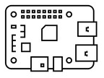

Client
Layer
Local network APIs
(tech user)
E-mail client
(Security user)
Business
Layer
ISAAC Core
(Workflow orchestrator,
SMTP server, blur service
Storage and DB management,
authentication, logging)
Key management
Support &
Data Layer
Enrypted FS
(frames, archived logs)
Oper. DB
(user, workers, events)
CV module
(SBC, Obj. Det. AI models)
Edge computing
Things
Layer
IP camera(s)

Slide 2
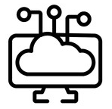
Client
Layer
Local network APIs
(tech user)
E-mail client
(Security user)
Business
Layer
Log, auth and data management
Notification module
Workflow orchestrator
Edge device manager
Key management
ISAAC Core
Support &
Data Layer
Enrypted FS
(frames, archived logs)
CV module
(SBC, Obj. Det. AI models)
Oper. DB
(user, workers, events)
Edge computing
Things
Layer
IP camera(s)

